Slide 1
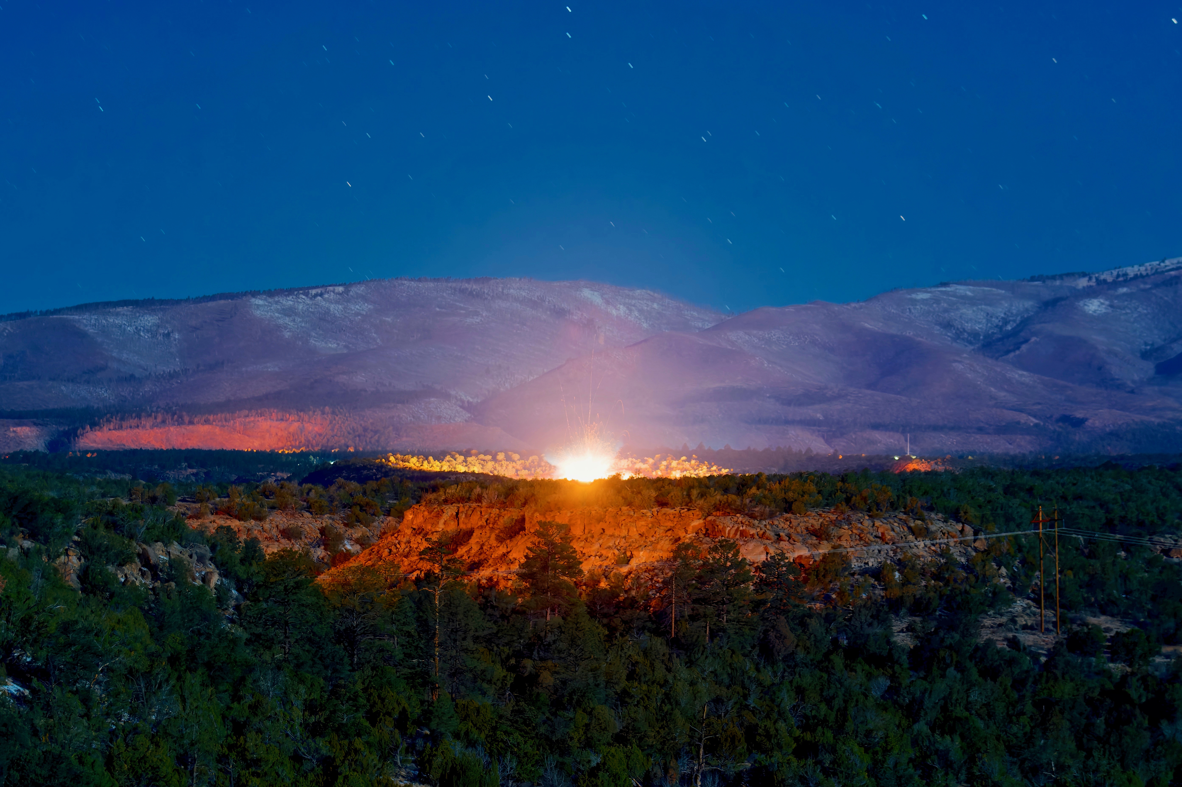
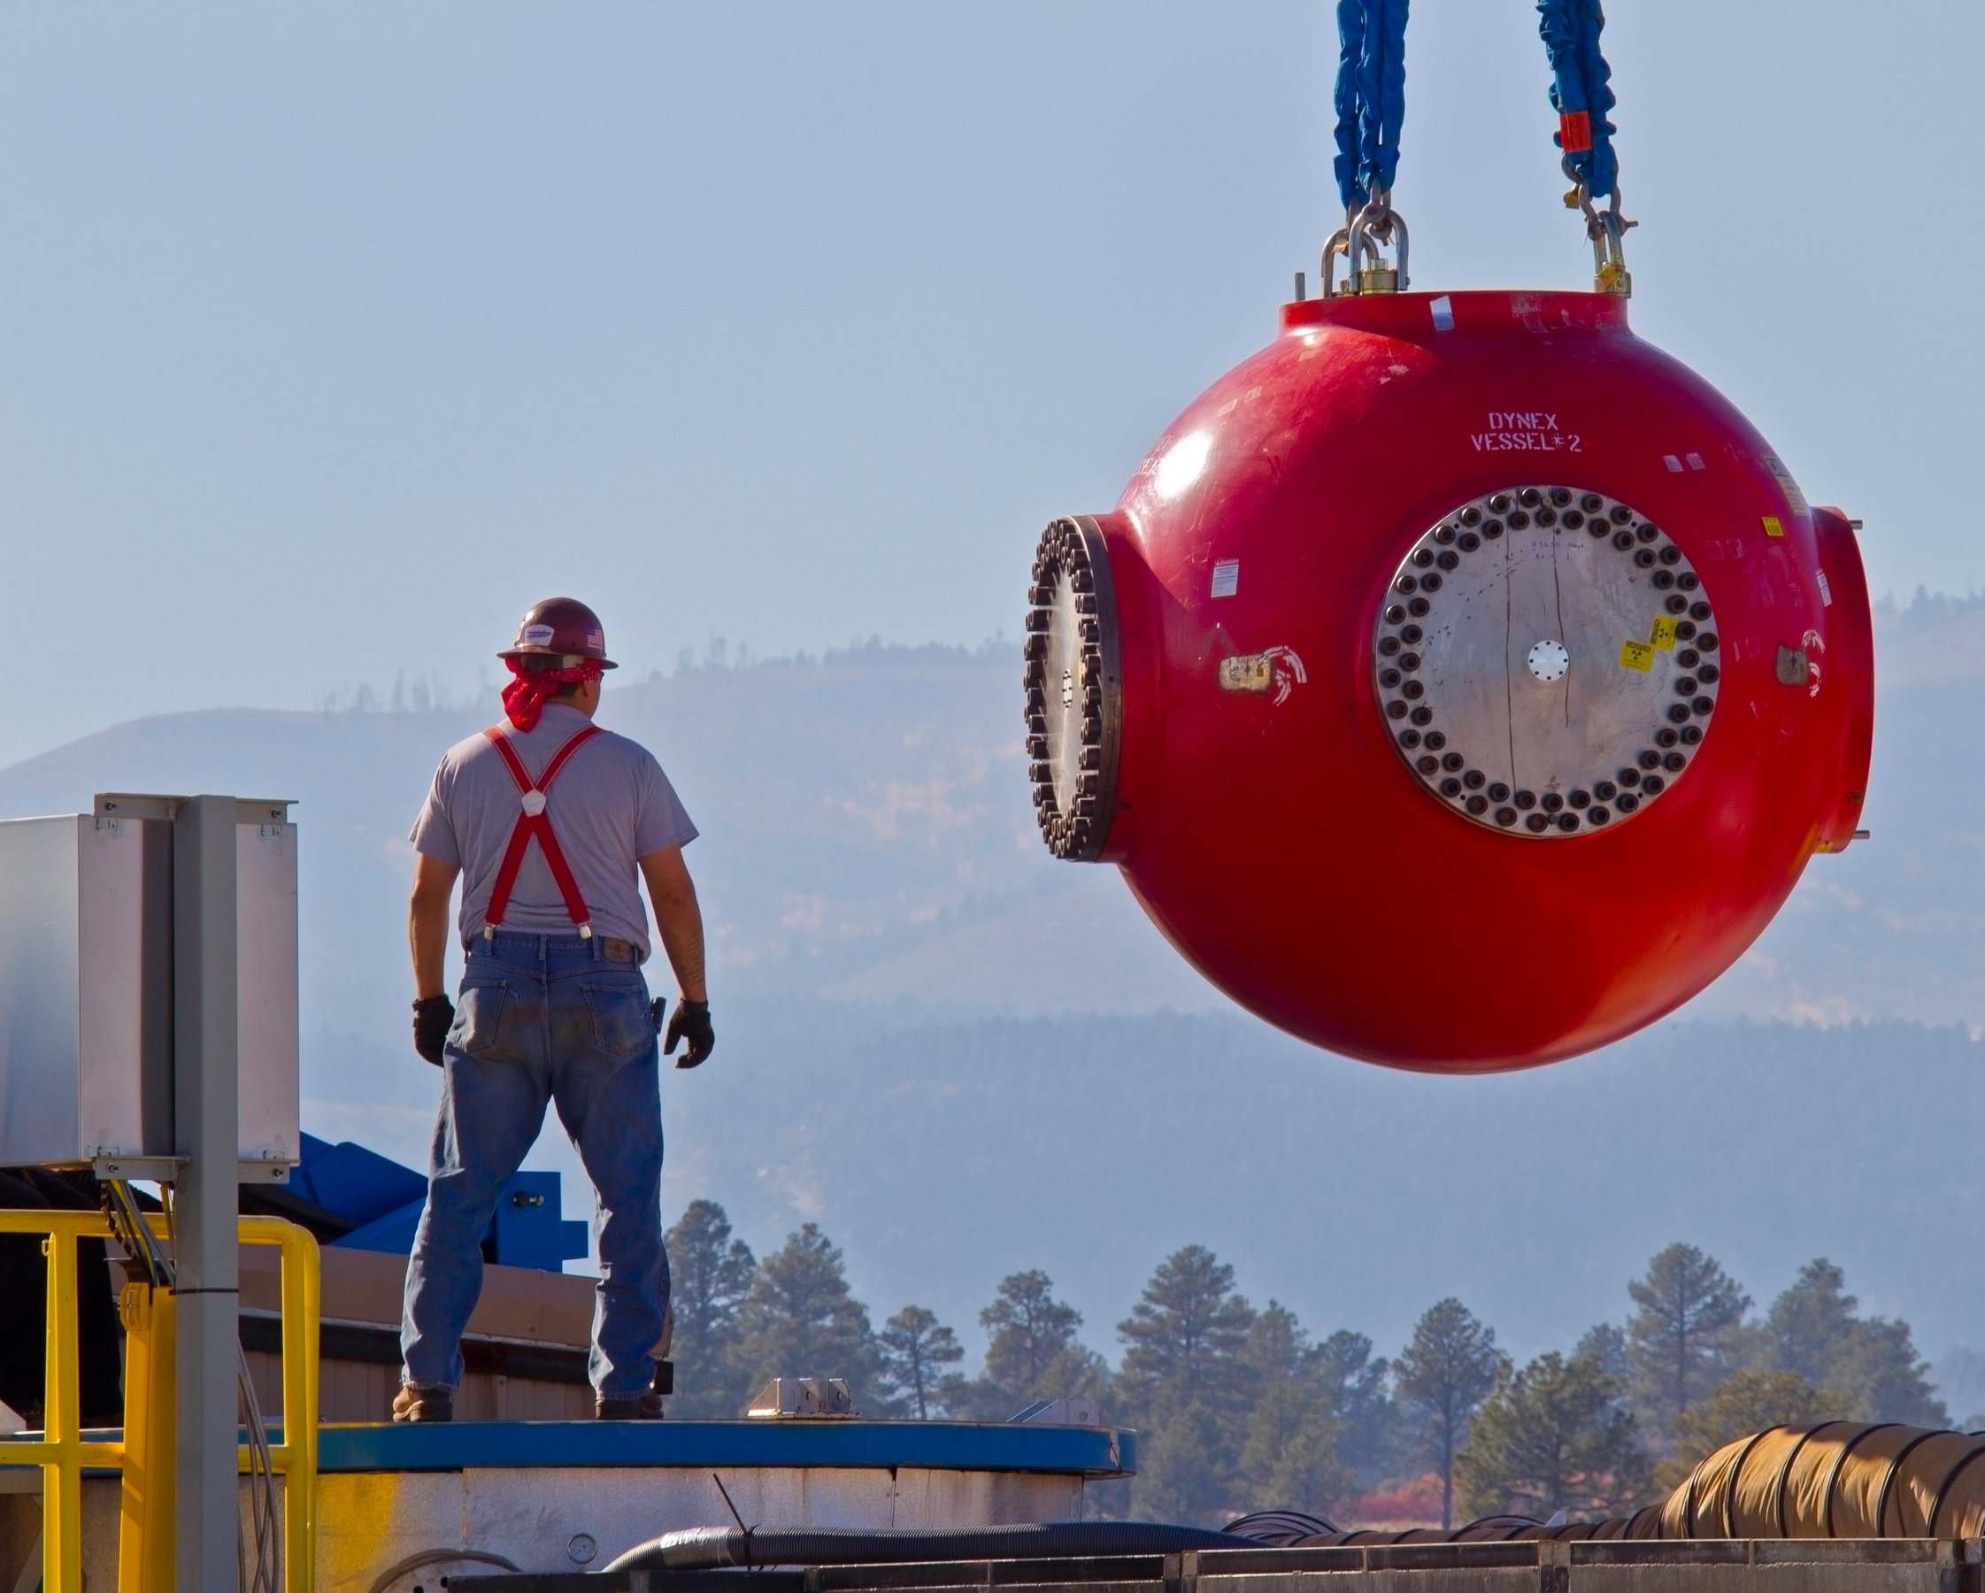
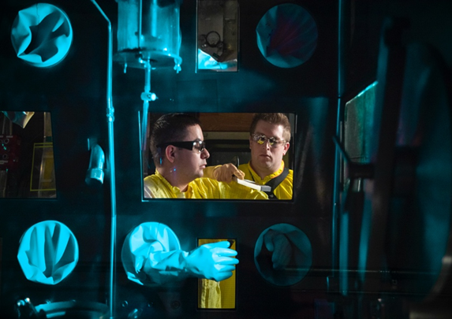
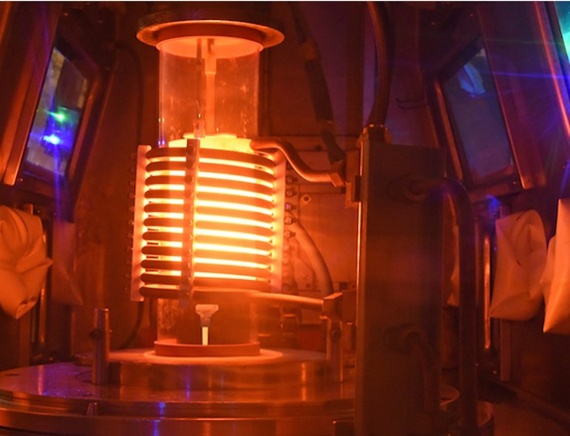
Opportunities at Los Alamos National Laboratory
Weapons Engineering (ALDW)
Weapons Production (ALDWP)
ALDWP is responsible for the production of plutonium pits, detonators, and non-nuclear components, along with the necessary evaluation that ensures safe and reliable products that support multiple aspects of the national security mission.
ALDWP is hiring engineers and engineering technologists from various subdisciplines who have graduated or will graduate in spring 2025, summer 2025 or fall 2025 with a BS, ME, MS, or PhD, and are available to begin full-time positions in Los Alamos, New Mexico, upon graduation.
Hiring managers will be conducting interviews for different positions in the Pit Technologies division. Your resume may also be shared with other divisions within ALDWP. If you are interested in being interviewed, complete the ALDWP Interview Interest Form here on or before Sunday, February 2, 2025. Early submission is encouraged. Selected candidates will be invited to schedule an interview on Tuesday, February 11, 2025, or Wednesday, February 12, 2025.
ALDW integrates planning and execution of the stockpile stewardship program, and sustains most deployed U.S. nuclear weapons, leads warhead modernization programs, and executes integrated experimental programs.
ALDW is hiring engineers and engineering technologists from various subdisciplines who have graduated or will graduate in spring 2025, summer 2025, or fall 2025 with an undergraduate or graduate degree, and are able to begin full-time positions in Los Alamos, New Mexico, upon graduation.
ALDW hiring managers will be conducting interviews for different full-time positions in the Directorate. If you are interested in interviewing, complete the ALDW Interview Interest Form here by Sunday, February 2, 2025. Early submission is encouraged. Selected candidates will be invited to schedule an interview on Tuesday, February 11, 2025, or Wednesday, February 12, 2025.
Our mission is to solve national security challenges through simultaneous excellence.

